Slide 1
Personality Prediction System

Slide 2
Introduction
In this work, we intent to develop a system that can predict one’s personality based on the post or status one uploads on the social media network.
This study is based on the prediction of Big Five Personality, MBTI (Myers-Briggs Type Indicator)
I-E: Extraversion (E) or Introversion (I)
N-S: Sensing (S) or INtuition (N)
T-F: Thinking (T) or Feeling (F)
J-P: Judging (J) or Perceiving (P)

Slide 3
Why Personality Prediction ?
Recruitment systems
Personal Counseling Systems
Computational Advertising,
Marketing Science
Enhanced Human-Computer Interaction
Bank Credit Scoring Systems.
People often update statuses, posts, comments to express their feelings and opinions on social media. These expressions can be used to characterize the individual’s behavior, personality, and characteristics of their thought patterns.

Slide 4
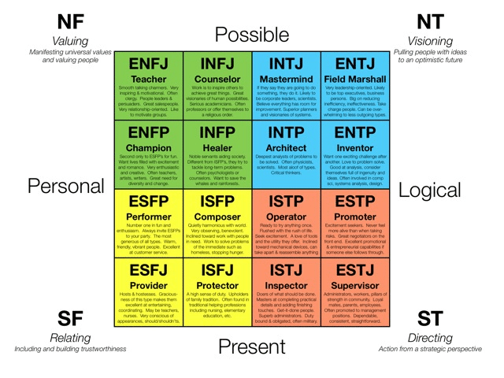

Slide 5
Literature Review
Comparison of machine learning algorithms for content based personality resolution of tweets
Shruti Garg, Ashwani Garg,
(https://www.sciencedirect.com/science/article/pii/S2590291121000747)
Personality Prediction Using Machine Learning
Shilpa R,Supriya V, Sweta Prasad , Vinaya Varshini R,Uday Shankar SV
(https://saejournal.com/wp-content/uploads/2021/07/Personality-Prediction-Using-Machine-Learning.pdf )
ABOUT MYER-BRIGGS TYPE INDICATOR https://rismakov.com/mbti-prediction/category/xgboost

Slide 6
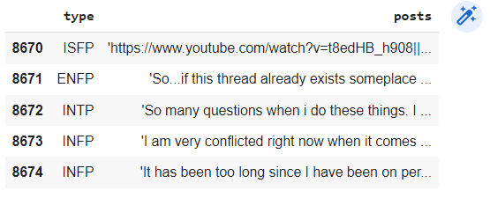
Dataset
The dataset used in this study is from the Myers–Briggs personality dataset which is openly available on Kaggle (https://www.kaggle.com/datasnaek/mbti-type ).
8675 unique value
First column : MBTI Personality Type
Second Column : 50 things they have posted.

Slide 7
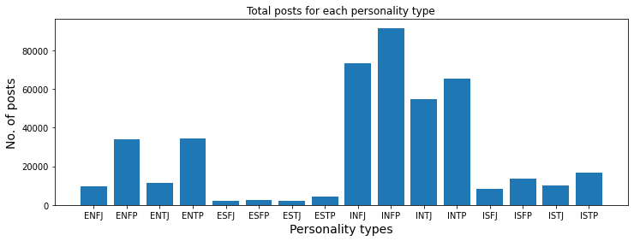
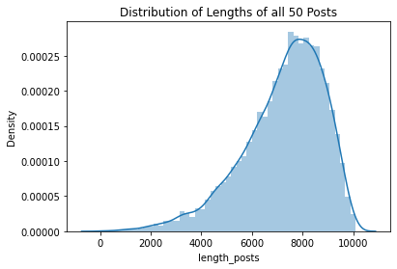
Visualizing Dataset

Slide 8
Tools used for Development
NLTK (natural language processing toolkit) and XGBoost
Frequency–Inverse Document Frequency
Pandas, numpy, re, seaborn, matplotlib and sklearn are other Python libraries are used
Notes:
The natural language processing toolkit (NLTK) and XGBoost which is an optimised distributed
Gradient Boosting library in Python, were used for the development process.

Slide 9
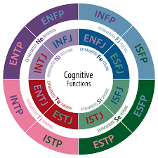
Pipeline
Preprocessing of Dataset
URL’s and Stop words were removed from the dataset.
Splitting the MBTI personality into four letters and binarising it.
the text was lemmatised, i.e., inflected forms of the words were transformed into their root words
2. Feature Engineering
Vectorise with Count and Term Frequency–Inverse Document Frequency (TF–IDF)

Slide 10
Pipeline (Contd.)
3. Splitting the Features:
X: user posts in TF-IDF representation
Y: Personality type in Binarised MBTI form
4. Training Model
In total, 70% of the data was used as the training set and 30% of the data was used as the test set. The model was fit onto the training data and the predictions were made for the testing data.

Slide 11
5. Evaluating Model
Random Forest Classifier
IE: Introversion (I) / Extroversion (E) Accuracy: 77.33%
NS: Intuition (N) / Sensing (S) Accuracy: 86.03%
FT: Feeling (F) / Thinking (T) Accuracy: 67.66%
JP: Judging (J) / Perceiving (P) Accuracy: 62.80%
XGBoost Classifier
IE: Introversion (I) / Extroversion (E) Accuracy: 77.65%
NS: Intuition (N) / Sensing (S) Accuracy: 86.06%
FT: Feeling (F) / Thinking (T) Accuracy: 68.77%
JP: Judging (J) / Perceiving (P) Accuracy: 64.83%
KNN Classifier
IE: Introversion (I) / Extroversion (E) Accuracy: 76.67%
NS: Intuition (N) / Sensing (S) Accuracy: 85.82%
FT: Feeling (F) / Thinking (T) Accuracy: 54.70%
JP: Judging (J) / Perceiving (P) Accuracy: 40.20%

Slide 12
Result and Conclusion
Out of all the models, seen above we see that on an average XG Boost gives relatively good performance, hence we choose it to build our Personality prediction model. This will be beneficial as XGBoost model can even be used to evaluate and report on the performance on a test set for the model during training.
The results show that the methodology has better accuracy and reliability in comparison to other existing methods. Regarding the knowledge contribution in this paper, the presented methodology significantly improved the accuracy of recognising the Intuition (I)–Sensing (S) and Introversion (I)–Extroversion (E) personality categories, as well as slightly better accuracy for the Judging (J)–Perceiving (P) personality category. This can effectively assist NLP practitioners and psychologists in regards to identification of personality types and associated cognitive processes.

Slide 13
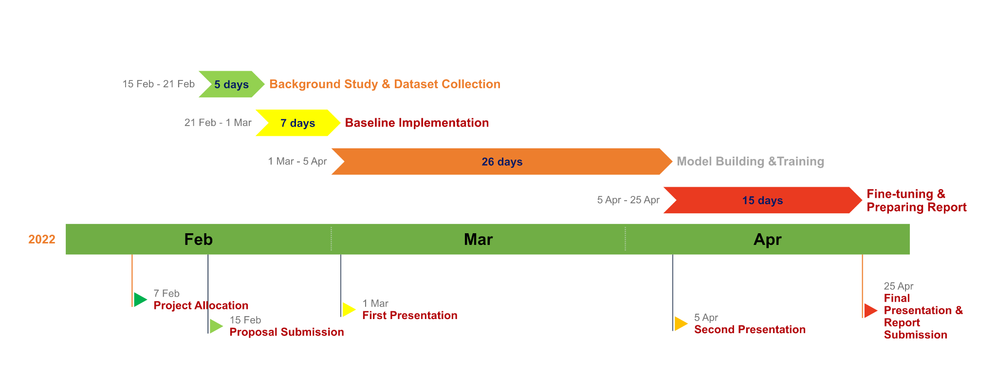
Timeline and Progress
Current Status

Slide 14
Work/Code
https://colab.research.google.com/drive/1kwwCyo_-HA9hIXDbXzT7xYVa-Qjg2L1y?usp=sharing

